Slide 1
TOPIC 1

Slide 2
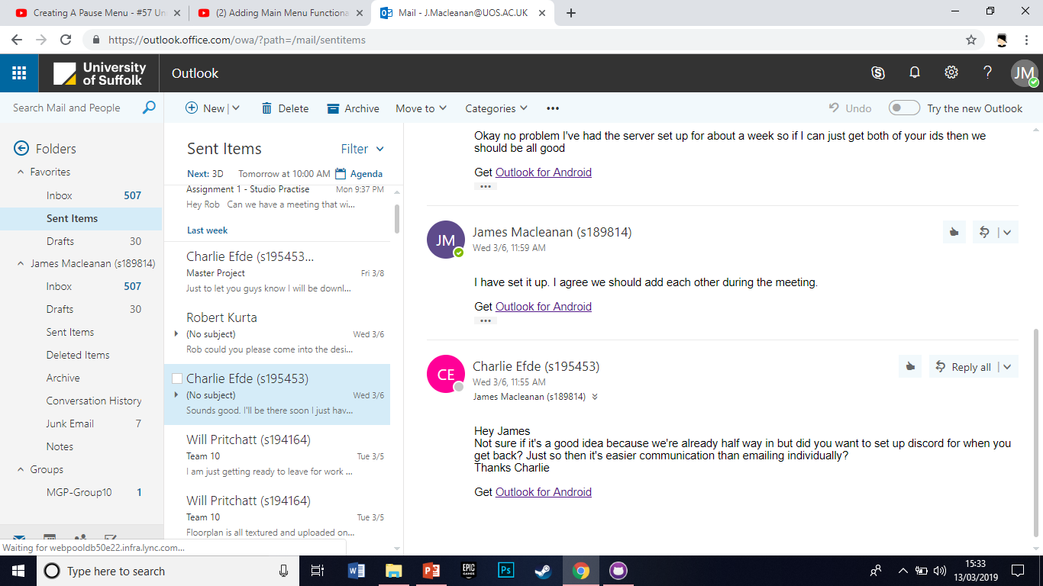
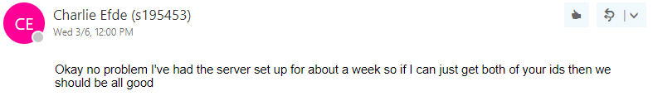

Slide 3
TOPIC 2

Slide 4
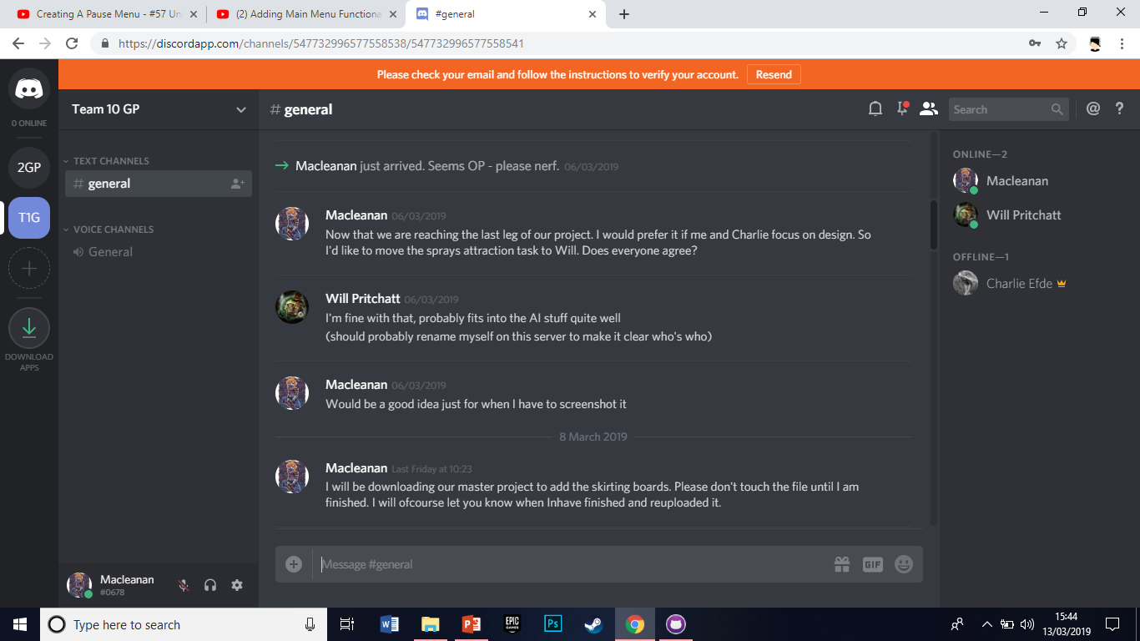

Slide 5
TOPIC 3

Slide 6
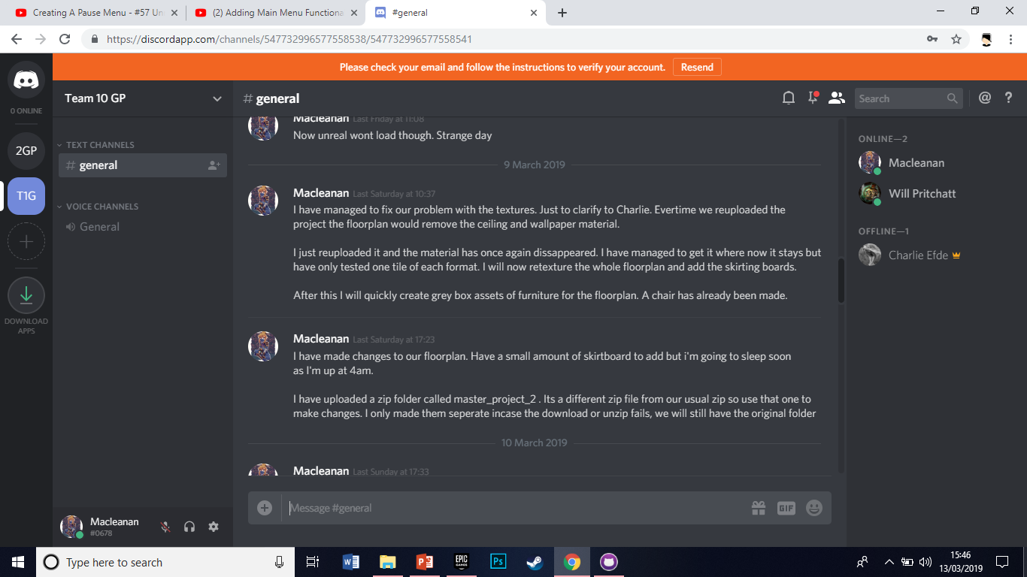

Slide 7
TOPIC 4

Slide 8
